Slide 1
Project Presentation
Ioannis Ioakeimidis, February 2014

Slide 2
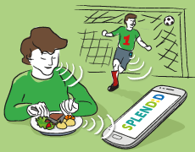
Aims
SPLENDID aims to develop a technological system to help measure, evaluate and offer feedback about eating and activity behaviour in real-life.

Slide 3
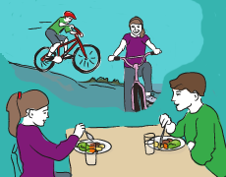
Aims
SPLENDID will offer personalized services guiding adolescents and young adults to adopt healthy eating and activity behaviors, preventing the onset of obesity and eating disorders

Slide 4
Key facts
The idea behind SPLENDID was submitted to EU as a 3-year project at January 2013

Slide 5
Key facts
The idea behind SPLENDID was submitted to EU as a 3-year project at January 2013
SPLENDID ranked 8th out of 254 applications
The project has been selected for receiving total funding of 2.7(3.5) M€ under the EU call: Personalized Guidance Services for lifestyle management and disease prevention
SPLENDID officially initiated 1rst October 2013

Slide 6
Key facts
The idea behind SPLENDID was submitted to EU as a 3-year project at January 2013
SPLENDID ranked 8th out of 254 applications
The project has been selected for receiving total funding of 2.7(3.5) M€ under the EU call: Personalized Guidance Services for lifestyle management and disease prevention
SPLENDID officially initiated 1rst October 2013

Slide 7
Key facts
The idea behind SPLENDID was submitted to EU as a 3-year project at January 2013
SPLENDID ranked 8th out of 254 applications
The project has been selected for receiving total funding of 2.7(3.5) M€ under the EU call: Personalized Guidance Services for lifestyle management and disease prevention
SPLENDID officially initiated 1rst October 2013

Slide 8
The approach
The system has three main components:
Measuring behaviour
Evaluating behavioural measurements
Modifying behaviour through feedback

Slide 9
The approach
Measurements of eating and activity behavior in real life conditions

Slide 10
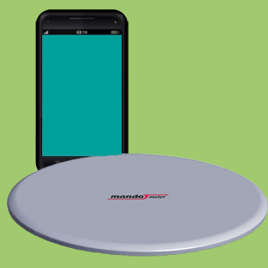
The approach
Measurements of eating and activity behavior in real life conditions
A plate with an attached scale measuring the rate of food consumption during a meal, i.e., the Mandometer

Slide 11
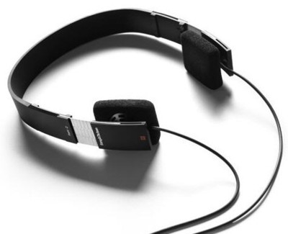
The approach
Measurements of eating and activity behavior in real life conditions
A plate with an attached scale measuring the rate of food consumption during a meal, i.e., the Mandometer
A chewing sensor measuring chewing during day

Slide 12
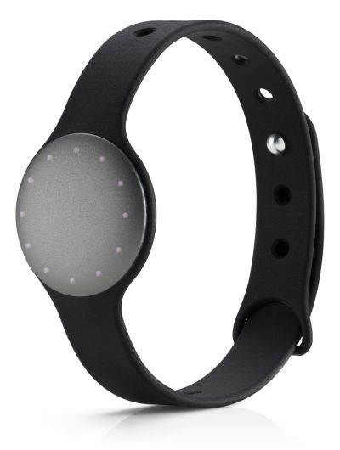
The approach
Measurements of eating and activity behavior in real life conditions
A plate with an attached scale measuring the rate of food consumption during a meal, i.e., the Mandometer
A chewing sensor measuring chewing during day
A wearable activity meter recording body motion during day

Slide 13
The approach
Measurements of eating and activity behavior in real life conditions
A plate with an attached scale measuring the rate of food consumption during a meal, i.e., the Mandometer
A chewing sensor measuring chewing during day
A wearable activity meter recording body motion during day
Subjective logs for fullness, intake
and daily activities

Slide 14
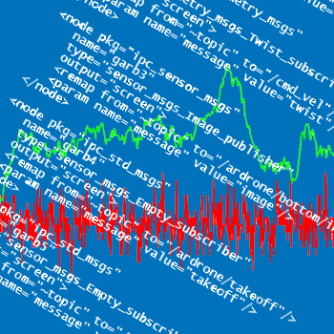
The approach
A pipeline of algorithms

Slide 15
The approach
A pipeline of algorithms
raw measurements pre-processing
(e.g., correct meal mistakes)
feature extraction (e.g., detect chewing events)
indicators quantification (e.g., detect an ongoing meal based on chewing events)
assessment of risk for obesity and eating disorders based on eating and activity behaviour patterns and personal profile data

Slide 16
The approach
A pipeline of algorithms
raw measurements pre-processing
(e.g., correct meal mistakes)
feature extraction
(e.g., detect chewing events)
indicators quantification (e.g., detect an ongoing meal based on chewing events)
assessment of risk for obesity and eating disorders based on eating and activity behaviour patterns and personal profile data

Slide 17
The approach
A pipeline of algorithms
raw measurements pre-processing
(e.g., correct meal mistakes)
feature extraction
(e.g., detect chewing events)
indicators quantification
(e.g., detect an ongoing meal based on chewing events)
assessment of risk for obesity and eating disorders based on eating and activity behaviour patterns and personal profile data

Slide 18
The approach
A pipeline of algorithms
raw measurements pre-processing
(e.g., correct meal mistakes)
feature extraction
(e.g., detect chewing events)
indicators quantification
(e.g., detect an ongoing meal based on chewing events)
assessment of risk for obesity and eating disorders based on eating and activity behaviour patterns and personal profile data

Slide 19
The approach
Normalizing eating and physical activity behaviour

Slide 20
The approach
Normalizing eating and physical activity behaviour
Use a Smartphone
Development of a professional
Portal for evaluation of measurements
and personalized behavioural goal
setting
Development of user-friendly system for delivering behavioural feedback (real-time and report-based) to the user, based on the behavioural goal set by the health professional

Slide 21
The approach
Normalizing eating and physical activity behaviour
Use a Smartphone
Development of a professional
Portal for evaluation of
measurements and personalized
behavioural goal setting
Development of user-friendly system for delivering behavioural feedback (real-time and report-based) to the user, based on the behavioural goal set by the health professional

Slide 22
The approach
Normalizing eating and physical activity behaviour
Use a Smartphone
Development of a professional
Portal for evaluation of
measurements and personalized
behavioural goal setting
Development of user-friendly system for delivering behavioural feedback (real-time and report-based) to the user, based on the behavioural goal set by the health professional

Slide 23
Scientific objectives
Correlate patterns detected on specific recordings of human generated signals to the risk of the development or aggravation of eating disorders and obesity
Eating style during meals
Daily physical activity patterns
Meal scheduling
Automatic evaluation of how close the close the subjects are to reaching their goals
Ontology
Monitoring

Slide 24
Scientific objectives
Correlate patterns detected on specific recordings of human generated signals to the risk of the development or aggravation of eating disorders and obesity
Eating style during meals
Daily physical activity patterns
Meal scheduling
Automatic evaluation of how close the close the subjects are to reaching their goals
Ontology
Monitoring

Slide 25
Scientific objectives
Correlate patterns detected on specific recordings of human generated signals to the risk of the development or aggravation of eating disorders and obesity
Eating style during meals
Daily physical activity patterns
Meal scheduling
Automatic evaluation of how close the close the subjects are to reaching their goals
Ontology
Monitoring

Slide 26
Technological objectives

Slide 27
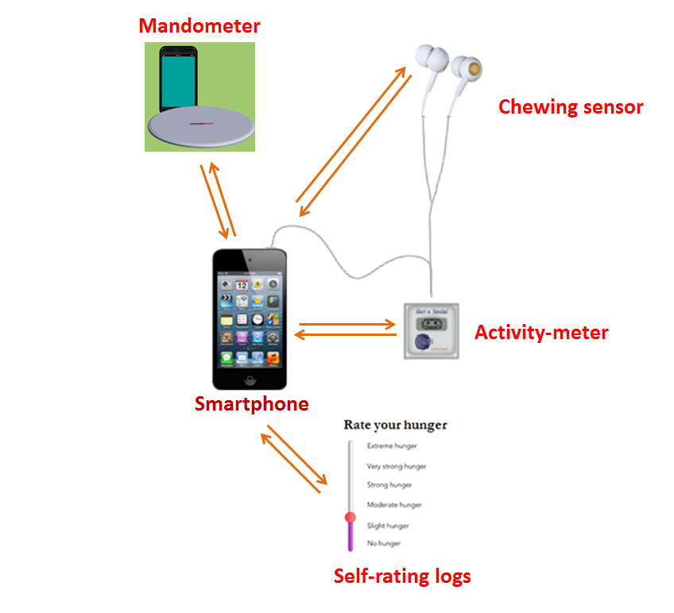
Technological objectives
Design and integration of sensors that capture eating behaviour and activity patterns
Design and implementation of a personalised monitoring and guidance platform

Slide 28
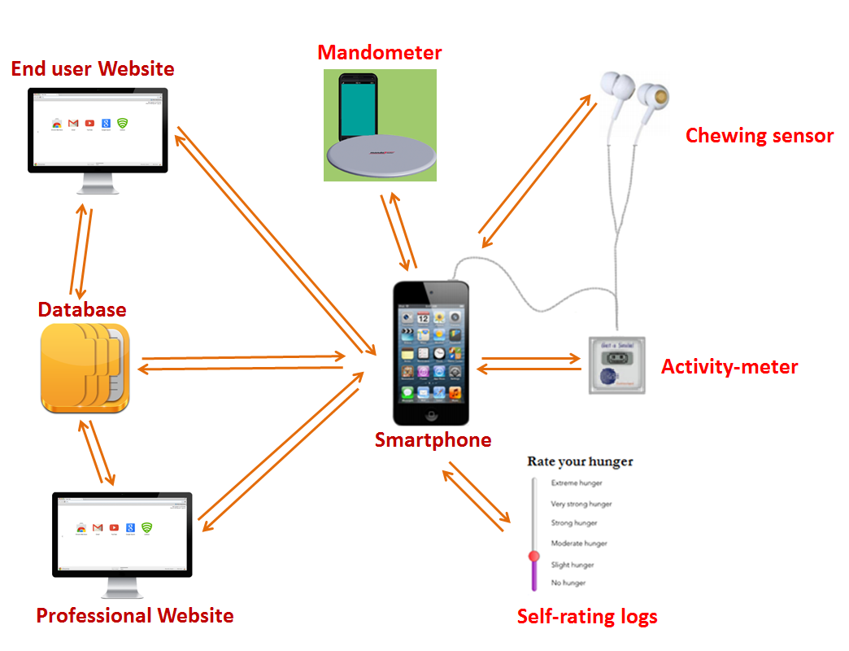
Technological objectives
Design and integration of sensors that capture eating behaviour and activity patterns
Design and implementation of a personalised monitoring and guidance platform

Slide 29
Indented uses

Slide 30
Indented uses
As a school screening programme (adolescents)
As a consumer lifestyle management service (young adults)

Slide 31
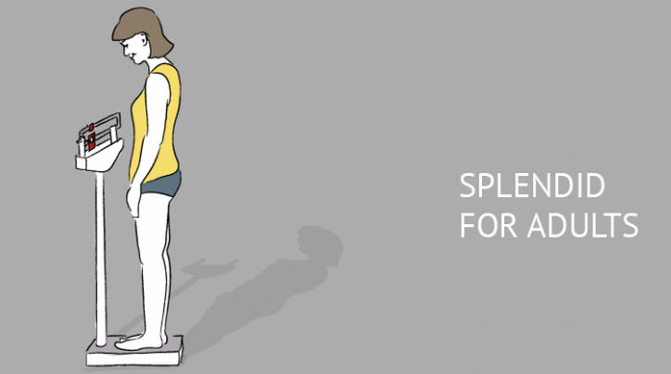
Indented uses
As a school screening programme (adolescents)
As a consumer lifestyle management service (young adults)

Slide 32
Workplan in a glance
V3: Final version
V2: 1st integrated prototype
V1: Non-integrated version
v3
v2
Pilot 2
v1
Pilot 1
Oct
2013
Jun
2014
Dec
2014
Sept
2015
Feb
2016
Sept
2016
First Sensor Prototypes
Sensor testing & data aquisition
1st workshop
Final Workshop

Slide 33
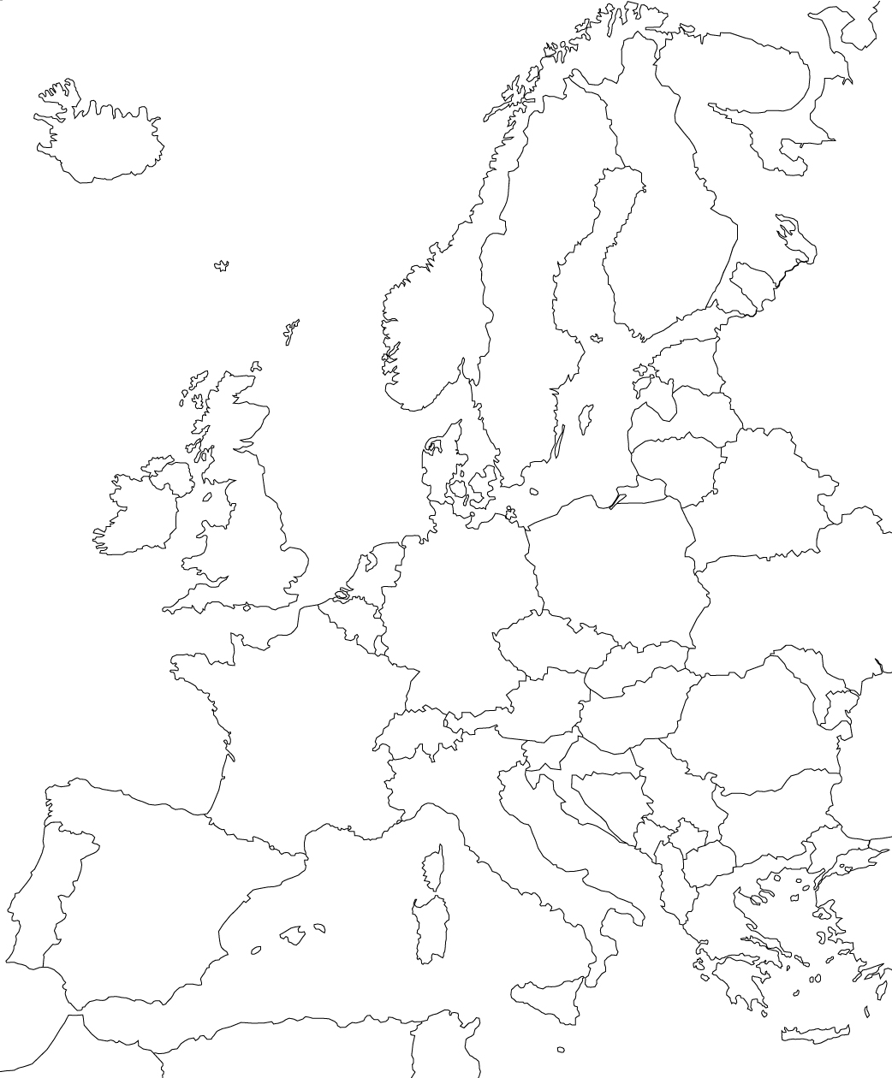
Consortium

Slide 34
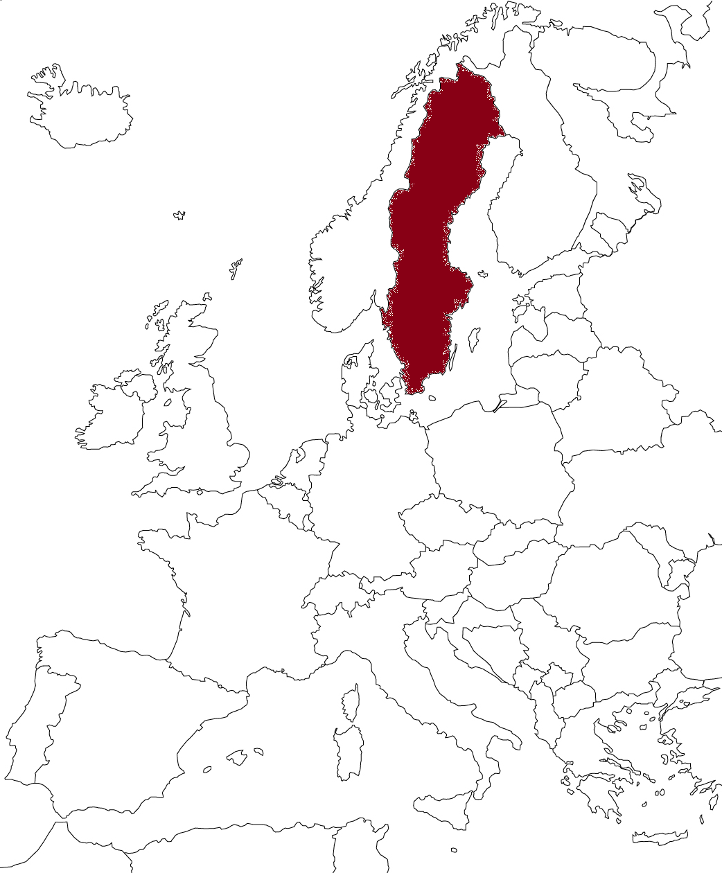
Consortium

Slide 35
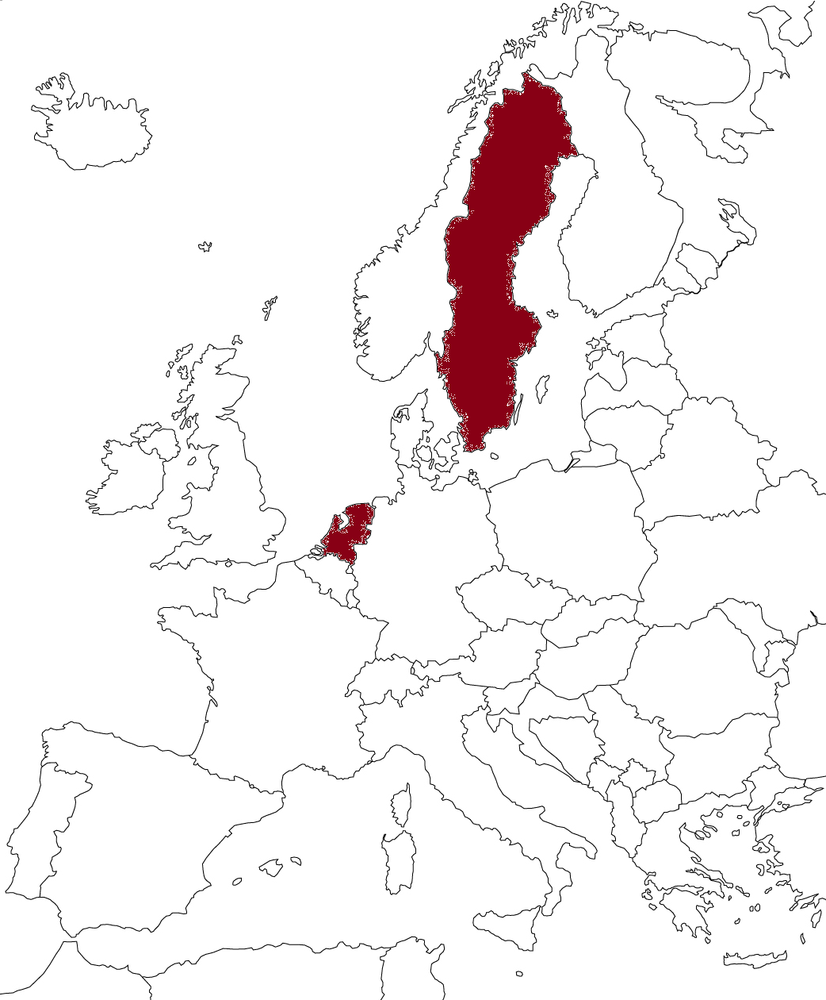
Consortium

Slide 36
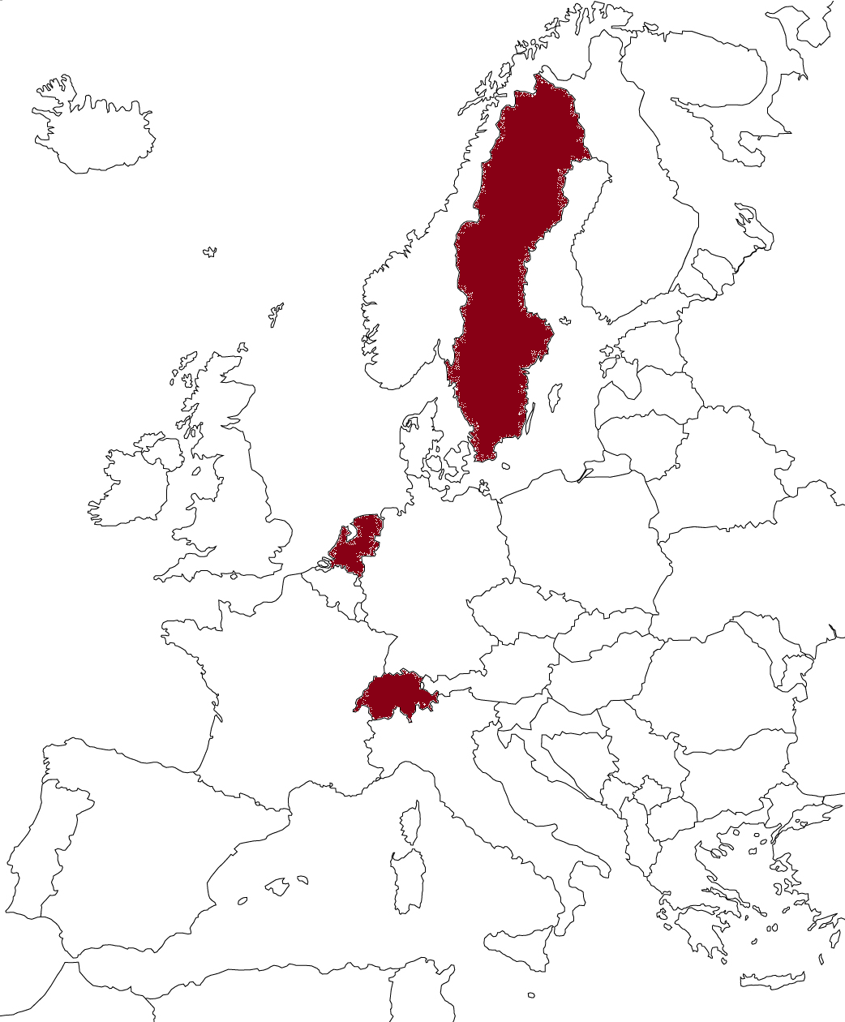
Consortium

Slide 37
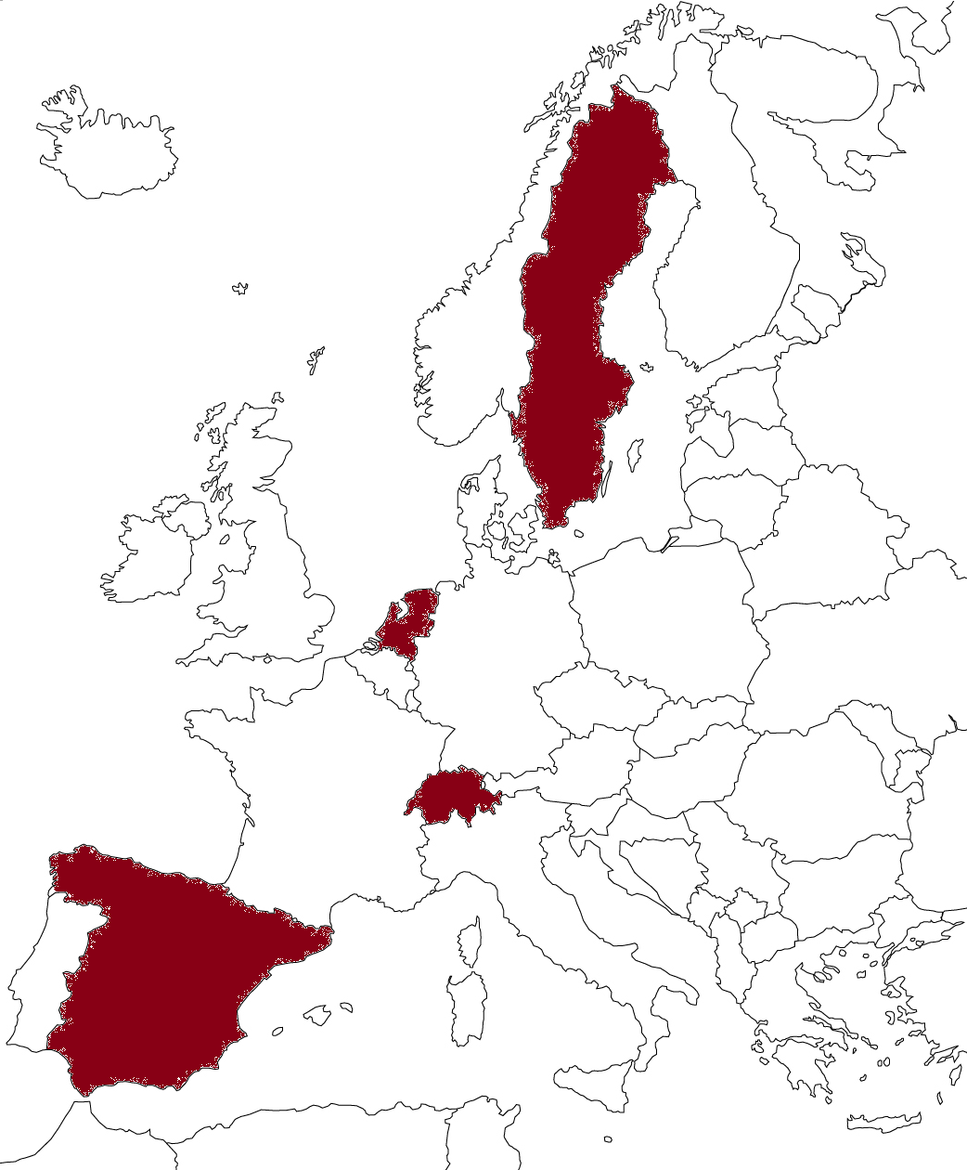
Consortium

Slide 38
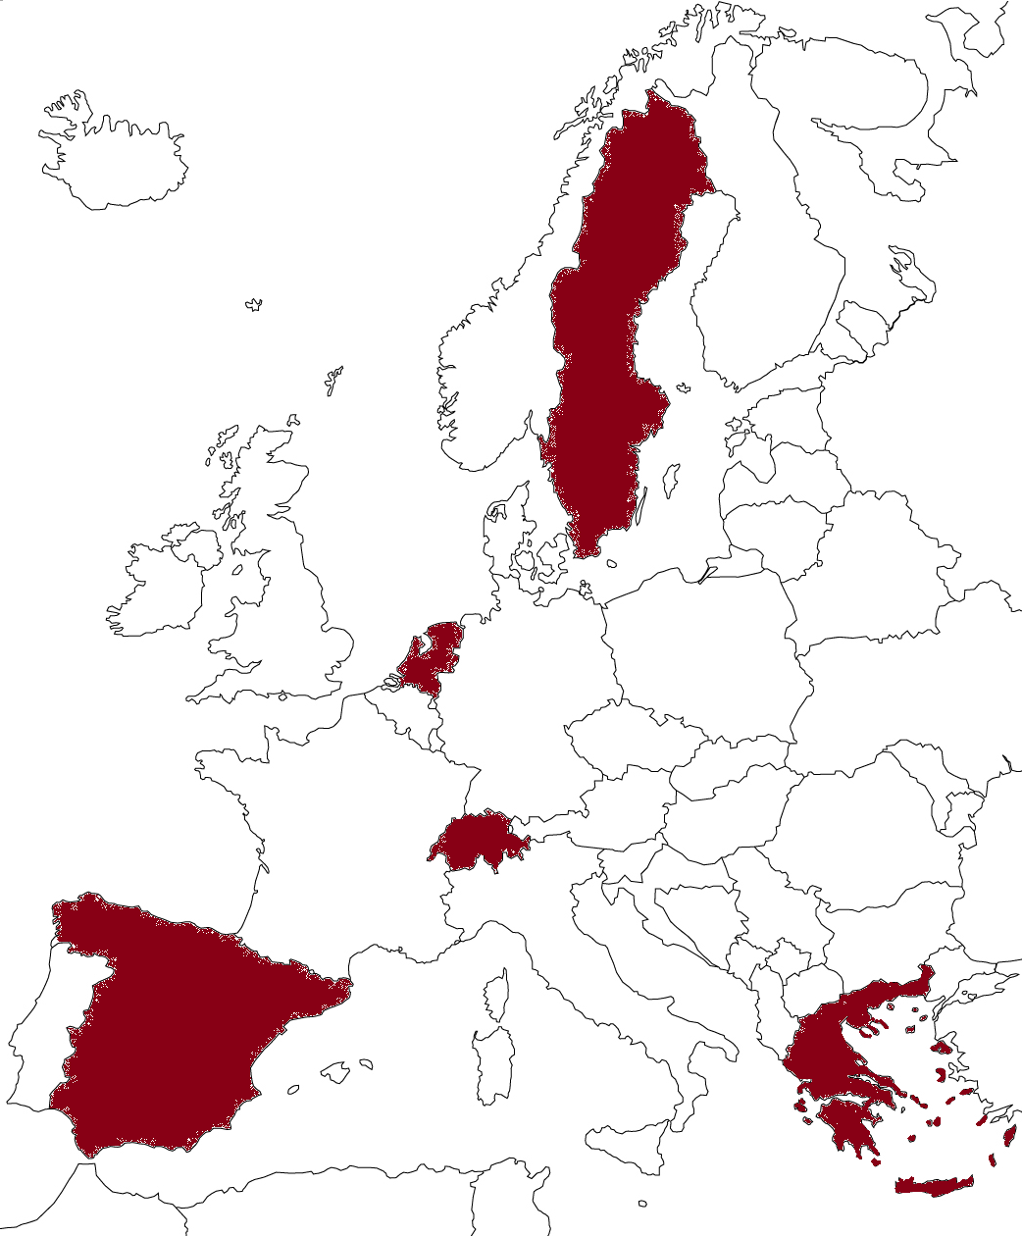
Consortium

Slide 39
Contact
Project Coordinator Prof. Anastasios Delopoulos Dept. of Electrical & Computer
Engineering Aristotle University of Thessaloniki Greece
adelo@eng.auth.gr
Dissemination Leader Cecilia Bergh, PhD Mando Group AB,
Stockholm, Sweden
Cecilia.Bergh@mando.se
http://splendid-program.eu/

Slide 40
Thank you!!!

Slide 41
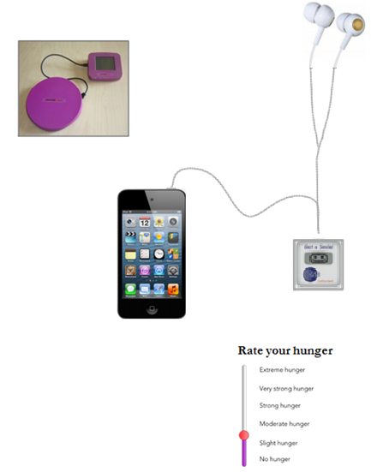
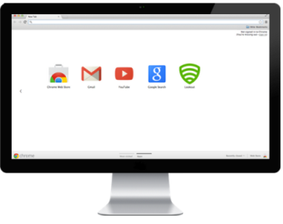
Mandometer
End user Website
Chewing sensor
Database
Activity-meter
Smartphone
Professional Website
Self-rating logs

